Slide 1

From Understanding to Preparation

Slide 2
Objectives
Discuss Data Understanding
Discuss Data Preparation
Data Science Methodology

Slide 3
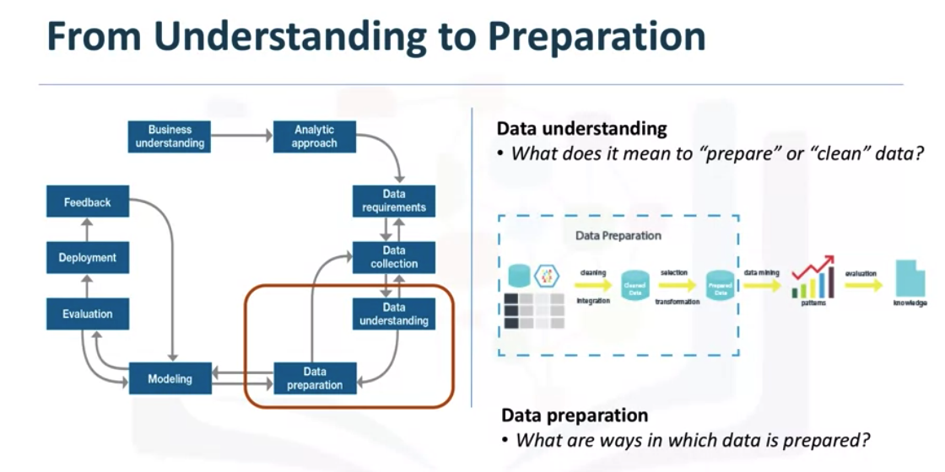
Data Understanding
Data Science Methodology

Slide 4
Data Understanding
Data understanding encompasses all activities related to constructing the data set.
Essentially, the data understanding section of the data science methodology answers the question: Is the data that you collected representative of the problem to be solved?
The question being asked is: What is the best way to allocate the limited healthcare budget to maximize its use in providing quality care? How do you think about data understanding?
Data Science Methodology

Slide 5
Data Understanding
In order to understand the data related to congestive heart failure admissions, descriptive statistics needed to be run against the data columns that would become variables in the model.
First, these statistics included Hearst, univariates, and statistics on each variable, such as mean, median, minimum, maximum, and standard deviation.
Second, pairwise correlations were used, to see how closely certain variables were related, and which ones, if any, were very highly correlated, meaning that they would be essentially redundant, thus making only one relevant for modeling.
Data Science Methodology

Slide 6
Data Understanding
Third, histograms of the variables were examined to understand their distributions. Histograms are a good way to understand how values or a variable are distributed, and which sorts of data preparation may be needed to make the variable more useful in a model.
From the information provided, certain values can be re-coded or perhaps even dropped if necessary, such as when a certain variable has missing values( missing or don’t know)
The more one works with the problem and the data, the more one learns and therefore the more refinement that can be done within the model, ultimately leading to a better solution to the problem.
Data Science Methodology

Slide 7
Data Preparation
In a sense, data preparation is similar to washing freshly picked vegetables in so far as unwanted elements, such as dirt or imperfections, are removed.
Together with data collection and data understanding, data preparation is the most time-consuming phase of a data science project, typically taking seventy percent and even up to even ninety percent of the overall project time.
Automating some of the data collection and preparation processes in the database, can reduce this time to as little as 50 percent.
This time savings translates into increased time for data scientists to focus on creating models.
Data Science Methodology

Slide 8
Data Preparation
Thinking about “we know that the process of chopping onions to a finer state will allow for its flavours to spread through a sauce more easily than that would be the case if we were to drop the whole onion into the sauce pot”
Similarly, transforming data in the data preparation phase is the process of getting the data into a state where it may be easier to work with.
Specifically, the data preparation stage of the methodology answers the question: What are the ways in which data is prepared?
To work effectively with the data, it must be prepared in a way that addresses missing or invalid values and removes duplicates, toward ensuring that everything is properly formatted
Data Science Methodology

Slide 9
Data Preparation
Feature engineering is also part of data preparation.
It is the process of using domain knowledge of the data to create features that make the machine learning algorithms work.
A feature is a characteristic that might help when solving a problem.
Features within the data are important to predictive models and will influence the results you want to achieve.
Feature engineering is critical when machine learning tools are being applied to analyze the data.
Data Science Methodology

Slide 10
Data Preparation
When working with text, text analysis steps for coding the data are required to be able to manipulate the data.
The data scientist needs to know what they're looking for within their dataset to address the question.
The text analysis is critical to ensure that the proper groupings are set, and that the programming is not overlooking what is hidden within.
The data preparation phase sets the stage for the next steps in addressing the question.
Data Science Methodology

Slide 11
Data Preparation
While this phase may take a while to do, if done right the results will support the project.
If this is skipped over, then the outcome will not be up to par and may have you back at the drawing board.
It is vital to take your time in this area, and use the tools available to automate common steps to accelerate data preparation.
Make sure to pay attention to the detail in this area.
Data Science Methodology

Slide 12
Data Preparation
The question being asked is: What is the best way to allocate the limited healthcare budget to maximize its use in providing quality care? How do you think about data preparation?
→The organization of data, separation or integration of information about the patient's medical history.
→ Eliminate sparse data, or try to recover lost data by interpolation, extrapolation methods
Data Science Methodology

Slide 13
Summary
Discuss Data Understanding
Discuss Data Preparation
Data Science Methodology

Slide 14
Q & A
Data Science Methodology

